Slide 1
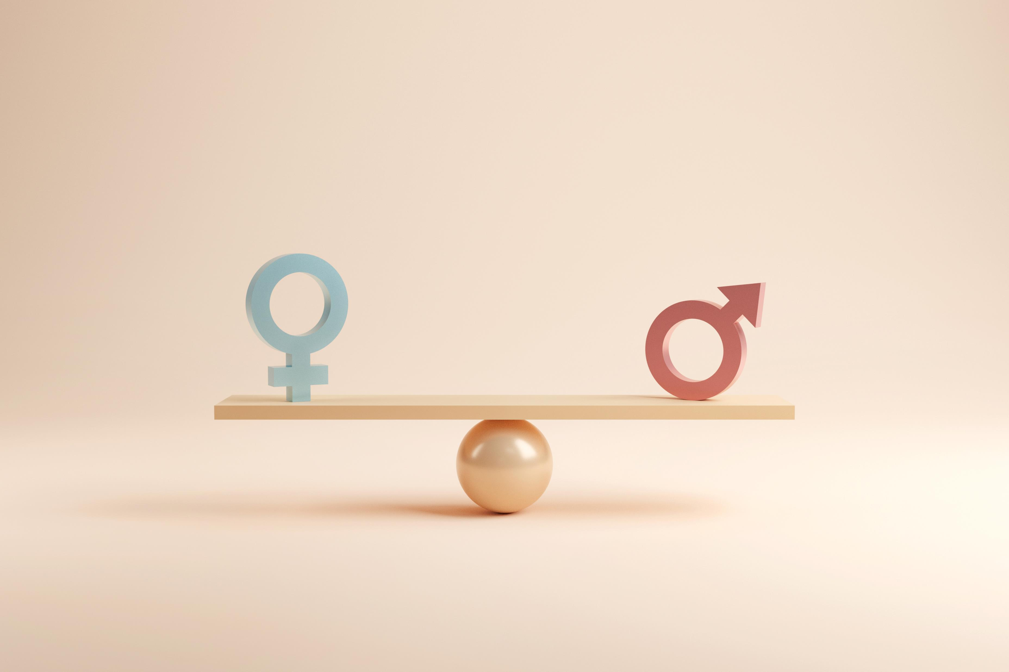




Global Gender Equality
A comparison study of gender equality and work between a selection of countries in all regions of the world based on employment and world development indicators from the World Bank Datasets

Slide 2
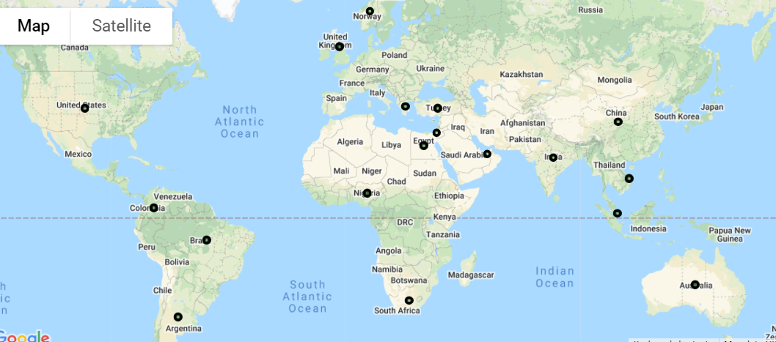
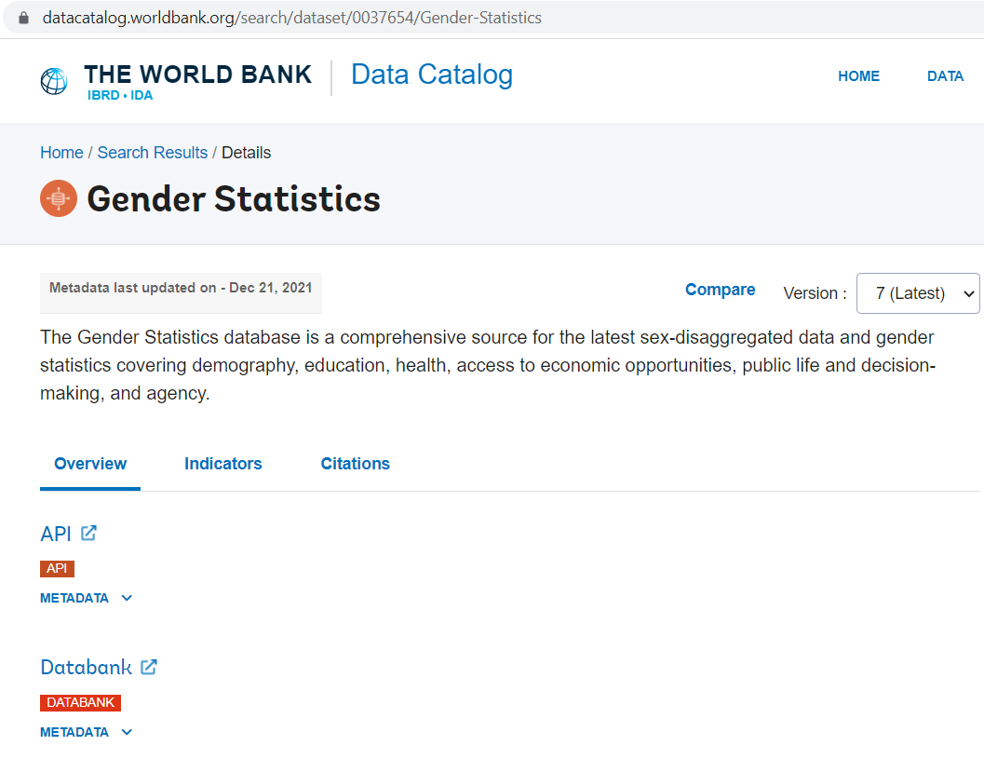
Gender Statistics, The World Bank Source: World Bank Data API
1
2
1. We gathered our research using The World Bank Gender Statistics Data Catalog including 922 indicators on 227 countries dating back to year 1960
We narrowed our scope down to 18 countries representing all continents and the following indicators as reported in 2018:
GDP per capita, PPP
Labor Force Participation Rates: % of Population Male/Female
Human capital index (HCI)
Population
Unemployment Rates % of labor force Male/Female

Slide 3
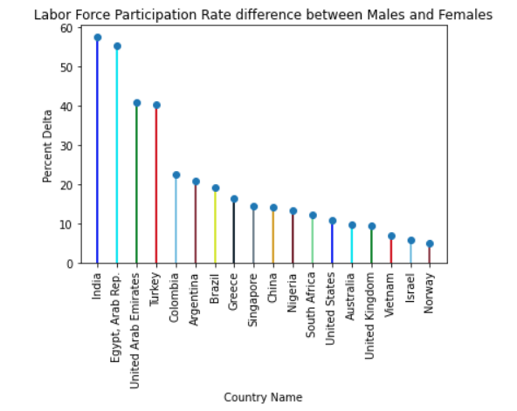
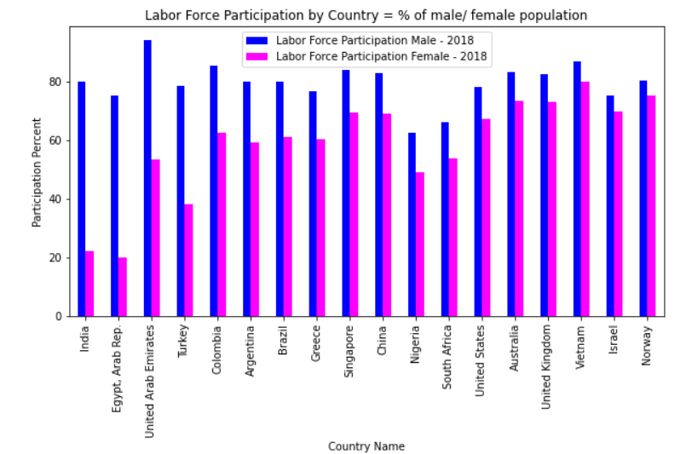
3
Creating attributes based on World Bank Data “Percent Delta” was created to measure Equality between Males and Females in the Work Force
We use the “Percent Delta” attribute to drive correlations to the other attributes within our study. We also created the attribute for to easily identify those countries in our study with higher rates of inequality to lower rates of inequality.

Slide 4
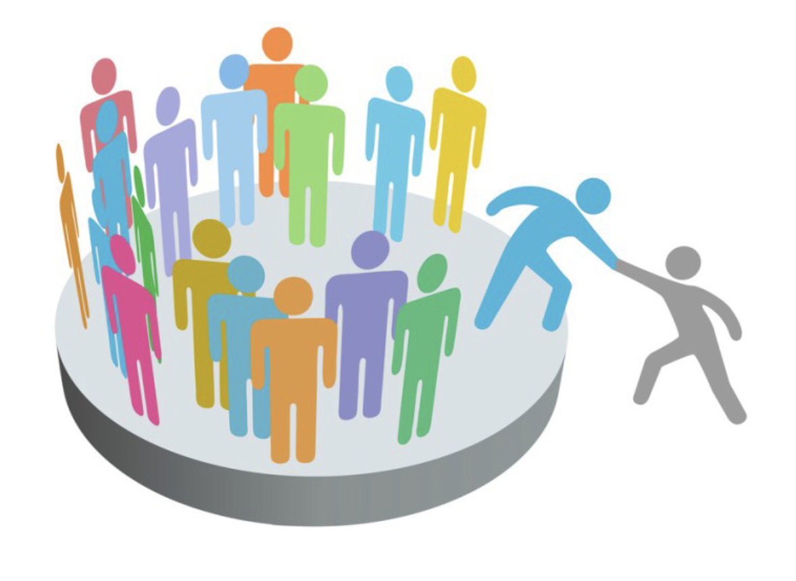
3
Human Capital Index (HCI)
Measures
51 indicators in 4 dimensions:
Study: The changing nature of work and economic refinement of the world today require societies to understand gender inclusion in human capital measurements.
We assessed quantifiable indicators form the workforce dimension of the index applying the Pearson correlation measure with a coefficient value range from -1 to +1.
Education
Health and Wellbeing
Workforce and Employment
Enabling Environment
Health
Related to individual’s and societies
current and expected
capacity to: acquire, develop and deploy skills

Slide 5
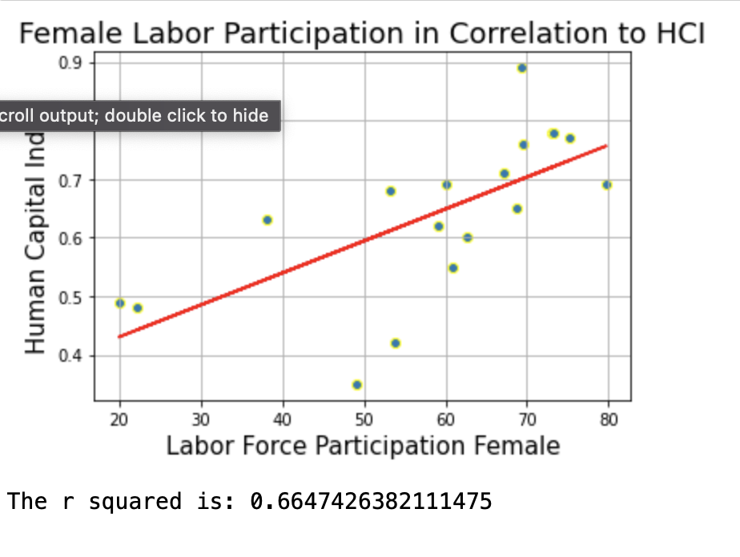
4
Human Capital Index (HCI)
Workforce and Employment
Research questions:
Is female labor participation related to a Human Capital Index (HCI) over 0.5?
We found a positive up hill correlation of 0.66 between female labor participation of women 15 to 64 years of age and HCI.
Further analysis is needed to understand the relationship since the variables may be conditioned by each other but not related. Female labor force participation is measuring economically activity women in 2018 and HCI predicts human capacity.
Health

Slide 6
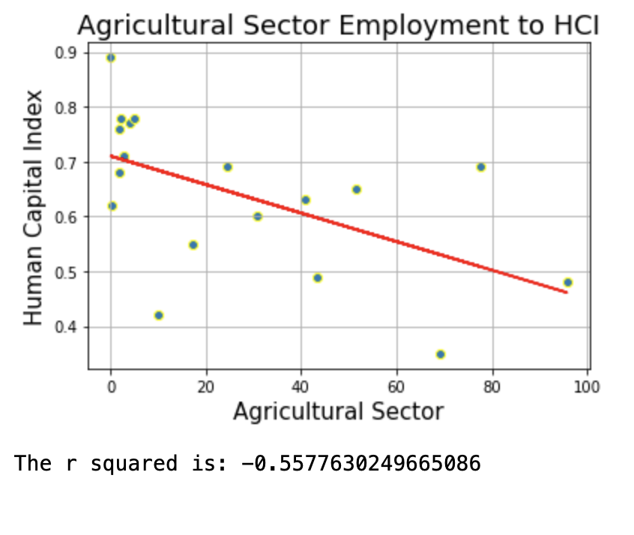
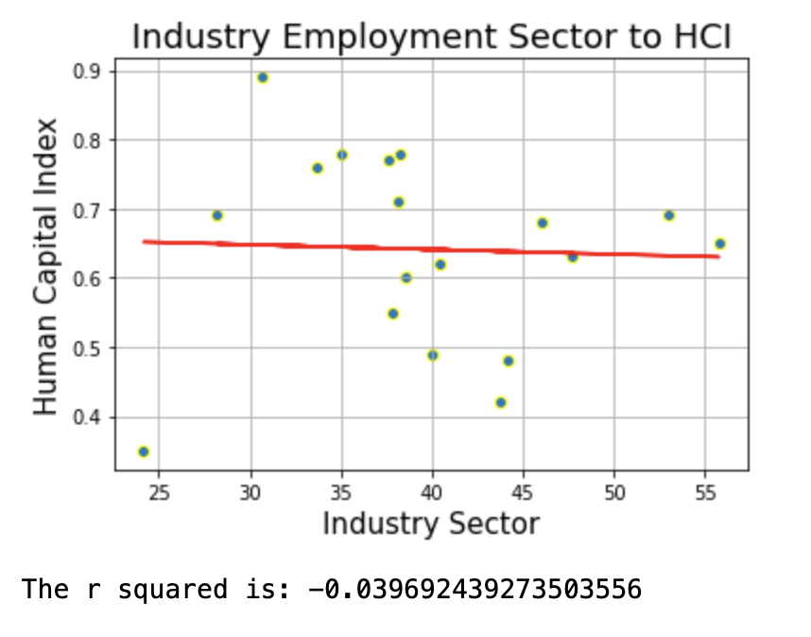
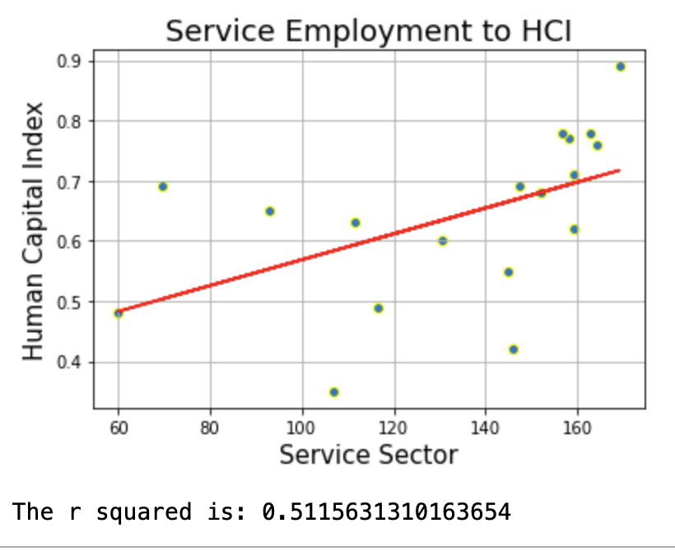
4
Human Capital Index (HCI)
Workforce and Employment
What is impact of labor sectors (agriculture, industry, services) on HCI ?
Research questions:
Health
We found a negative down hill correlation between employment in agriculture and industry sectors in relation to HCI.
Employment in the service sector has a positive up hill correlation of 0.5 to HCI. Illustrating the dynamic nature of the Human Capital Index and how it relates to shifts in economic activities.

Slide 7
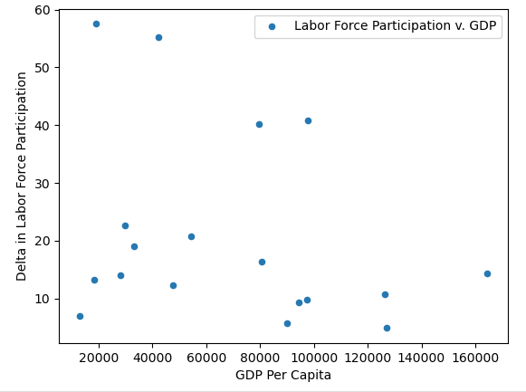
Comparing GDP and labor force participation
We sought to discover whether there was a correlation between gender gap in labor force participation and overall economic performance in that country.
We measured the difference between female and male participation rates and GDP per capita based on purchasing power parity.
We found that there was no linear correlation (R Value -0.28) for the countries examined.
We suspect that because only 18 countries were included that our sample size may have been too small and included too many outliers to detect a correlation. (P Value 0.25)

